Slide 1
Prediction of Breast Cancer-Related Genes/Proteins Using Machine Learning
Tereza Rosier

Slide 2
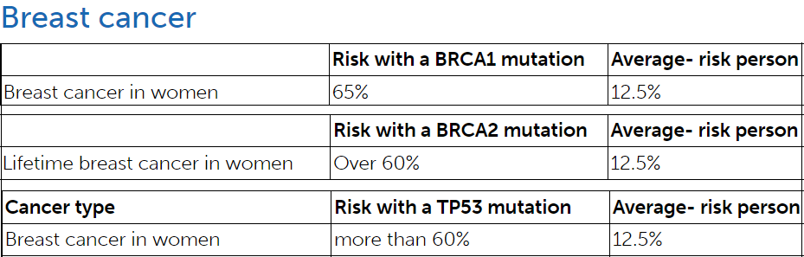
Introduction
Binary System x Genes Protein
Gene Mutation Protein Malfunction
Breast cancer genes
BRCA2
BRCA1
TP53
HER2
ATM
CHEK2
PIK3CA
PTEN
CDH1
PALB2
Genetic Testing: decision-making in the doctor-patient relationship
Cell Growth Regulation
DNA Repair
Apoptosis (programmed cell death)
Cancer
Angelina Jolie

Slide 3
Project
Dataset:
DisGeNet
Harmonizome 3.0
Pre-processing:
Merge 4 datasets
Rename the synomym GeneIDs as per official names
Dropped GeneIDs != genes chosen
Function (def preprocess_data(df, frac=1))
Normalization (StandardScaler): numerical features
One-Hot Encoding: categorical features
Label encoder: dependent variable
Classification method: Logistic Regression and Random Forest
Train/Test

Slide 4
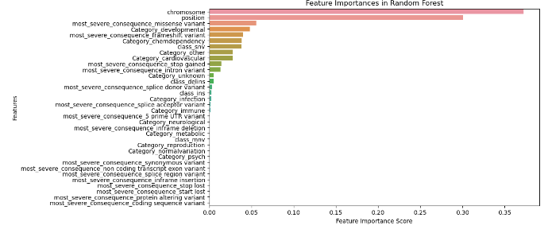
Features

Slide 5
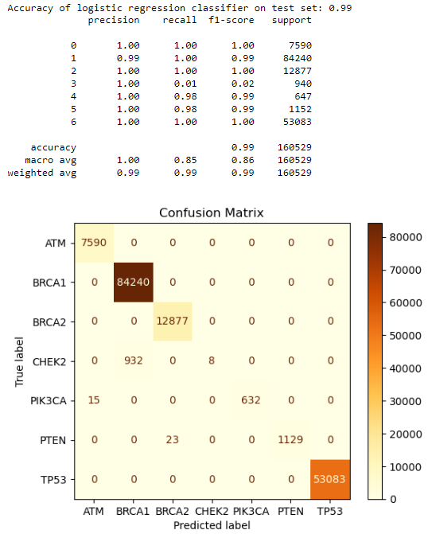

Logistic Regression X Random Forest
Basic

Slide 6
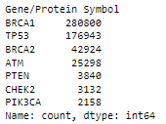
Unbalanced data
Value_counts():
Balancing data:
Logistic Regression:
model = LogisticRegression(solver='liblinear', penalty='l1', C=1, max_iter=1000, class_weight="balanced")
Random Forest:
rf_model = RandomForestClassifier(
n_estimators=100,
max_depth=4,
min_samples_split=2
min_samples_leaf=1,
random_state=42,
class_weight="balanced")
hyperparameters from GridSearch

Slide 7
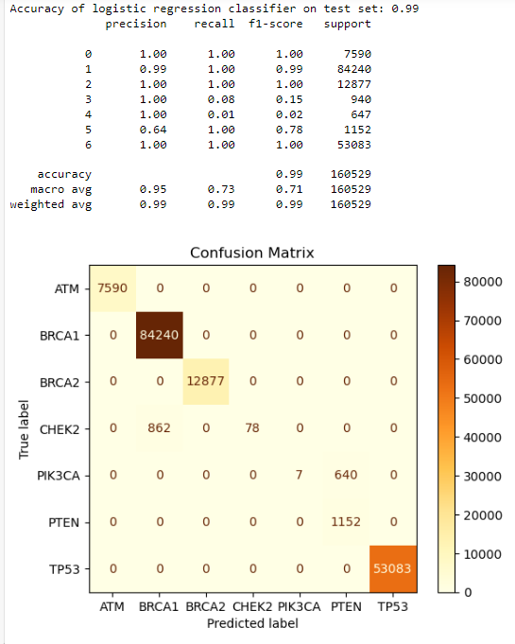
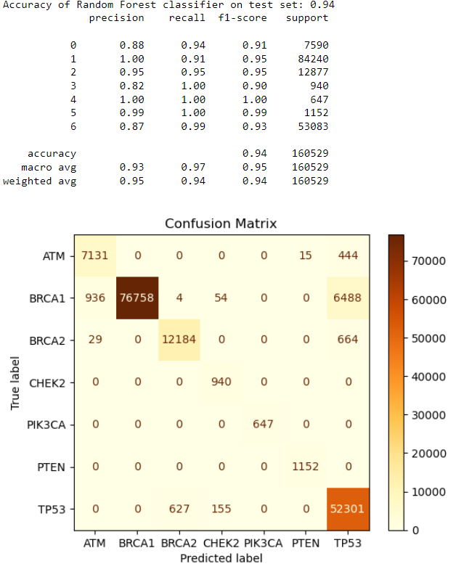
Logistic Regression X Random Forest
Balancing the data: “class_weight=balanced”

Slide 8

Impact on class 4:
Upsampling and Balancing data:
Logistic Regression:
ros = RandomOverSampler(sampling_strategy={3: y.value_counts()[3] * 7}, random_state=42)
model = LogisticRegression(solver='liblinear', penalty='l1', C=1, max_iter=1000, class_weight="balanced")
Random Forest:
ros = RandomOverSampler(sampling_strategy={3: y.value_counts()[3] * 7}, random_state=42)
rf_model = RandomForestClassifier(
n_estimators=100,
max_depth=4,
min_samples_split=2
min_samples_leaf=1,
random_state=42,
class_weight="balanced")
hyperparameters from GridSearch

Slide 9
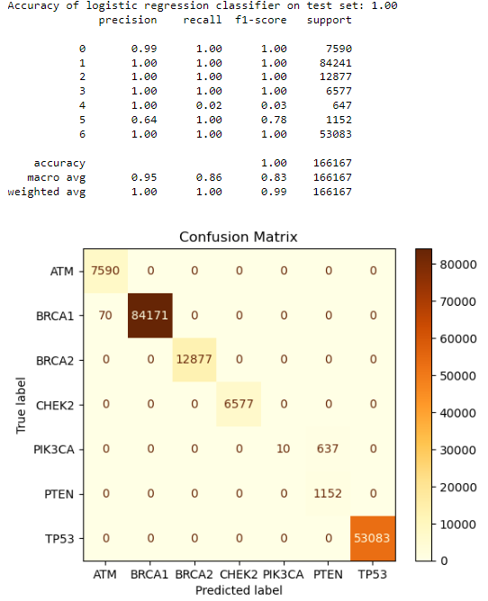
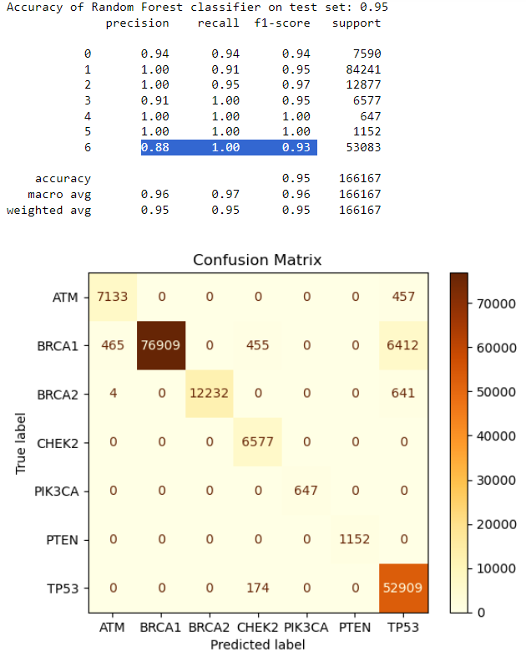
Logistic Regression X Random Forest
Upsampling (7x/class 3) with RandomOverSampler + “class_weight=balanced”

Slide 10
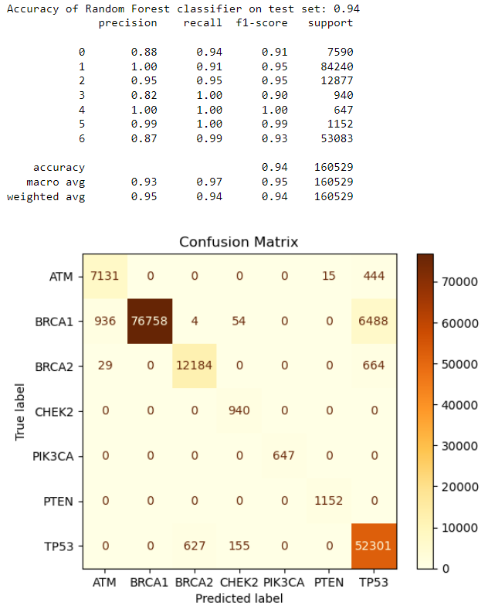
Final Considerations
The machine learning model demonstrates strong performance in predicting breast cancer-related genes/proteins. The overall accuracy of the model is 95%, indicating that the model correctly predicts the gene/protein in 95% of the cases.
Classes 4 and 5 represent genes whose mutations are not very impactful. This likely means that the characteristics of these mutations are more homogeneous and less complex, making it easier for the model to classify them correctly. As a result, the model exhibits high precision, recall, and F1-score for these classes, demonstrating its efficiency in handling less impactful mutations.
Benchmark: over 90%
source: Benchmarking 50 classification algorithms on 50 gene-expression datasets
https://www.biorxiv.org/content/10.1101/2021.05.07.442940v1.full

Slide 11
“When researchers discovered that the HER2 gene had links to breast cancer growth, it led to the development of treatments that have significantly improved the survival rates for people with HER2-positive breast cancer”

Slide 12
Source
https://maayanlab.cloud/Harmonizome/
https://www.disgenet.org
https://www.cancer.gov
https://www.cancerresearchuk.org
https://www.medicalnewstoday.com
https://www.facingourrisk.org
https://www.biorxiv.org
https://thebiogrid.org/

Slide 13
Streamlit repo:
https://gene-prediction.streamlit.app/

